Slide 1
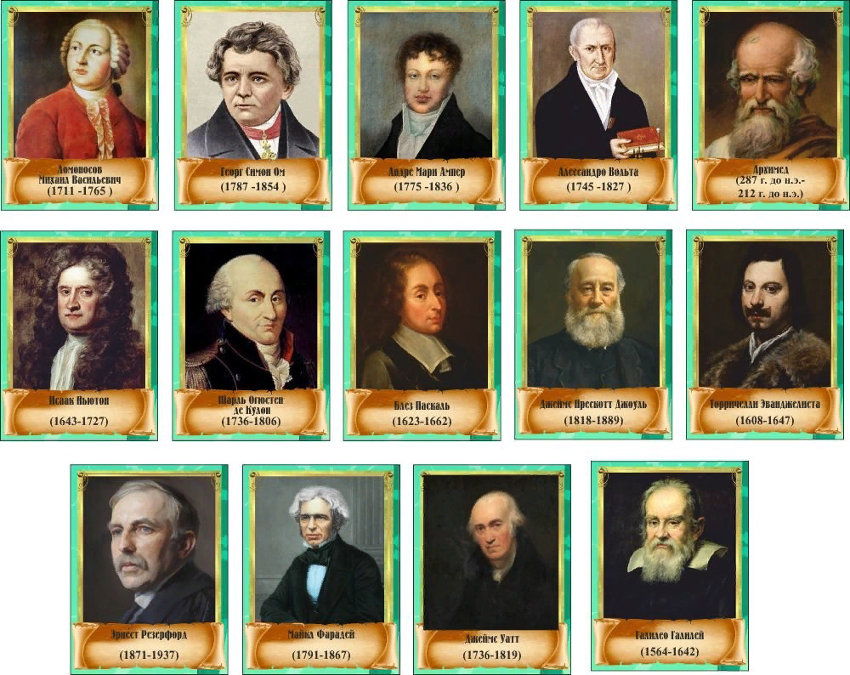

Slide 2
GREAT MINDS- Великие умы, т.е. ЛЮДИ

Slide 3
Characteristic features
One should be
(Confident, easy-going, determined, sociable, talented, intelligent, funny, curious, imaginative, athletic, artistic, creative, gifted)
to become a scientist.
(choose several words)

Slide 4
Mistakes that worked Some of the inventions were the results of hard work in the laboratories, others (not many though) were the results of Mistakes. p.46, ex.1

Slide 5
Alexander Fleming (1881-19550)
1.What is the name of a scientist?
2. When did he make his discovery?
3. How did his discovery help people?

Slide 6
Find the correct definition of the text: a drama, a humorous story, a detective story, a science fiction, an adventure, a biography.
Let me introduce myself. My full name is Irina Nikolayevna Snatkina. I’m 16 years old. I was born on November 11th, 2002 in Rostov-on-Don. It is a large city in southern Russia. I grew up and studied in this city. Many young people would want to be on my place as Rostov opens up career opportunities.
Peter I went down in Russian History as a great reformer. A regular army and navy, iron copper industries, a lot of technical schools and an academy of sciences were established by the order of Peter I the Great. The brilliant victories won by the Russian army in the Northern War, which lasted more than twenty years and which gave Russia a firm hold on the Baltic coast were also the work of Peter the Great.
The first historical example of crime fiction is probably a novel The Three Apples. It was a part
of One Thousand and One Nights, which is a collection of old Arabic folk tales. The novel
lacked any typical features of a modern murder mystery, but still tried to set up a crime scene
as a plot² device. Other tales from this collection also describe some bits and pieces³ of actual
crime investigation.
Black holes are areas in the universe where gravity pulls in everything, even light. Nothing can get out and all objects are squeezed into a tiny space. Because there is no light in black holes we cannot see them. But scientists can detect the immense gravity and radiation around them. They are the most mysterious objects in astronomy. Scientists think that the first black holes were formed when the universe began about 13 billion of years ago.

Slide 7
Цитаты о книгах
«Если вы хотите, чтобы ваши дети были умными, читайте им сказки. Если вы хотите, чтобы они были умнее, читайте им больше сказок».
Альберт Эйнштейн.

Slide 8
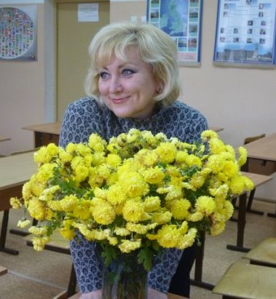
I wish you to learn hard, be determined, curious and creative to become Great minds!
2023-2024

